Slide 1
Agenda
December 11, 2018
The rest of the Semester
15 minutes to finish Test from last class
Trade and Grade Test (If you were absent last class take test and textbook into the hall and continue working—you will finish this during advisory on Wednesday, December 12th in room 440)
Trade and Grade Book work from last week
Unit 5 Vocabulary read-discuss-glue in journal
Begin notes on The Republic of Texas 1836-1845
Continue notes on the Republic of Texas 1836-1845
Making the Grade: Houston vs. Lamar WS
Finish Republic of Texas Notes
Create How Texas Got its Shape Foldable
American Progress Analysis WS

Slide 2
On the next blank page in your journal write the title:
Republic of Texas 1836-1845
Read and discuss the Vocabulary Terms as a class
Glue into your Journal
Begin Notes

Slide 3
The Republic of Texas 1836-1845
Big Ideas:
The presidents of the Republic Texas had very different philosophies about what was best for Texas.
Texas faced significant political and economic problems as a republic.
The United States’ annexation of Texas had far-reaching political consequences.

Slide 4
Major Issues of the Republic
Massive amounts of debt- could not pay government officials or army
-Owed 1.25 million dollars (7 million dollars today)
Mexico and other foreign countries recognize Texas as independent
Native American raids/attacks
Ways to raise money:
-Placed a tax/tariff on imported goods
-Placed a tax on property and livestock
-Sent most of the Texan soldiers home to reduce cost of army
-Called upon Texas Rangers (military/state police force) to protect Texas
By 1839 debt had jumped to 2 million dollars

Slide 5
Sam Houston becomes President
September 5, 1836 (2 months early)
The first president of the Republic to be elected by the people of Texas
Mirabeau Lamar elected Vice President of the Republic
Stephen F. Austin Secretary of State
Made Columbia the capital of Texas- 1837 Houston became new capital
The new nation faced many issues and challenges
Goals:
-Get the new Texas Republic out of debt
-Peace with Native Americans
-Foreign countries to recognize Texas as a new Republic (country)
-Avoid conflict with Mexico

Slide 6
Córdova Rebellion--August 1838 to March 1839
Occurred during Sam Houston’s first term as President of the Republic
Rebellion of Tejanos living in Texas against the new Texas Republic
-Tejano: Person of Mexican descent living in Texas
Led by Vincent Córdova with the “secret” help of Mexico
Battle near Seguin
-Tejano rebels were defeated
-Rebellion ended

Slide 7
Seeking Annexation into the U.S.
Annexation: the process of one country taking over part or all of another country
In the election of Houston in September of 1836, Texans voted in favor of the Republic of Texas being annexed into the U.S.
United States refused to annex Texas, feared that it would cause trouble with Mexico
March of 1837- U.S. recognizes Texas as independent, does not annex
The Texans continued to favor annexation throughout the entire period of the Republic

Slide 8
Mirabeau Lamar- 2nd President of Texas
Texas Constitution prohibited Presidents serving two consecutive terms (“in a row”)
Lamar wins election on December 10, 1838
He opposed many of Sam Houston’s goals
-Annexation by the U.S.
-Texas could become powerful country by itself
-End the threat posed by Mexico and Native Americans (by using force)
Native Americans had no legal claim to land in Texas
After Cordova Rebellion- believed Natives working for Mexico
-Expanded the size of the Rangers and Texas Navy
-Printed money excessively
1839: Lamar moves state capital to Austin
Big supporter of Education in Texas- “Father of Education”
-Believed that citizens need to be educated to make good decisions
-Set 18,000 acres in each county to build schools
-2 pieces of land reserved: Texas A&M and University of Texas

Slide 9
Issues with Cherokee
In July 1839- Texas army following the orders of President Lamar, forcibly removed the Cherokee natives from Texas
Battle of Neches
-Occurred during the removal of Cherokee
-Several Texans were killed
-Over 100 Cherokee killed

Slide 10
Council House Fight
After several raids by the Texas Rangers into Comanche territory in 1839. The Comanche asked for a peace treaty with the Republic of Texas. The Texas leaders agreed to meet with the Comanche to discuss a treaty, but only if the Comanche returned all white settlers that they took prisoner.
The meeting took place on March 19th, 1840 at San Antonio’s Council House. The Comanche return only one prisoner, a teenage girl, who reported that the Comanche still had several Texans prisoner.
A fight quickly broke out between the Comanche and Texans. In the fighting 7 Texans were killed, along with 35 Comanche.

Slide 11
Comanche Reprisal
In reprisal for the Comanche's killed at the Council House fight. The Comanche started to raid Texas settlements, killing settlers and livestock.
In response to these attacks, Texas military forces chased the Comanche and fought them in several battles and eventually forced them to move north of the Red River.
Lamar also ordered the Texas army to attack other Native American village, causing much suffering for the tribes.
Lamar’s policy towards Native Americans failed to bring a lasting peace.

Slide 12
Lamar’s Foreign Policy
Lamar dreamed of Texas remaining an independent country and eventually stretching to the Pacific Ocean.
He also wanted Mexico to recognize Texas as an independent country.
In order to protect Texas, Lamar expanded to Texas Navy by ordering 8 new ships. Lamar ordered the Texas Navy to help Mexican rebels in the Yucatan province. Lamar hoped that Mexico would be too busy with the rebels in the Yucatan to worry about Texas.

Slide 13
Santa Fe Expedition
Santa Fe is located in present day New Mexico, an area both Mexico and Texas claimed in 1841. Lamar believed controlling Santa Fe, an important trading center, was the first step in Texas expansion to the pacific Ocean.
In June 1841, ordered a force of 300 soldiers, and merchants, under the command of Jose Navarro, to travel to Santa Fe, and invite it to join the Republic of Texas.
The expedition was intercepted by Mexican soldier, and forced to surrender. The Texans were imprisoned in Santa Fe, where many died .
The survivors were eventually released.

Slide 14
Lamar’s Economic Policies
The war against Native Americans, expansion of the Texas Navy, and The Santa Fe expedition cost larges amounts of money.
By the time Lamar left office, Texas’s debt had risen to 8 million dollars.
Texas attempted to create its own paper currency called redbacks, but with no gold or silver to back it up the paper currency quickly lost value.

Slide 15
Sam Houston’s 2nd Term
In September 1841, Sam Houston was elected President of the Republic of Texas for a second time.
In a speech to the Texas legislature, Houston presented his plan to undo most Lamar’s domestic and foreign policies.
Houston planned on working to cut government spending, make peace with the Native Americans, and get Texas annexed by the United States.

Slide 16
Cutting Cost
In an attempt to cut government spending, Houston fired many government employees, and cut the salaries of others.
Houston attempted to sell the small Texas Navy, but the citizens of Galveston blocked to him.
Despite his efforts, by the time Houston left office, Texas’s debt was almost 12 million dollars by 1846.

Slide 17
Peace with Native Tribes
Houston renewed peace efforts with Native tribes, and attempted to treat the tribes fairly.
He established trading posts to provide the tribes with supplies, and convinced 11 tribes to sign peace, and trade treaties.

Slide 18
Trouble with Mexico
In March 1842, 700 Mexican soldiers invaded Texas, and captured San Antonio. They quickly withdrew back to Mexico. As a result of the Mexican invasion, Houston ordered the archives or stored official government documents moved from the Texas capital of Austin.
Many citizens in Austin were convinced that Houston wanted to move the capital back to the City of Houston.
The Texas Rangers arrived in Austin to move the archives, citizens of Austin started shooting at the Rangers.
This event became known as the archives war. The archives, and the capital, remained in Austin.

Slide 19
Meir Expedition
Without orders, in December of 1842, a force of 300 Texas soldiers under the command of Colonel Fisher crossed the Rio Grande, and invaded Mexico. This was in response to several Mexican invasions of Texas.
The Texas soldiers attacked the Mexican town of Meir. The Texans were defeated by a force of 900 Mexican soldiers who arrived to protect the town.
176 Texas soldiers were taken prisoner.

Slide 20
The Black Bean Episode
Santa Anna, who was back in power (this occurred 11 times over the course of 20 years in Mexico), ordered 1 out of every ten Texas prisoners to be executed.
The prisoners were forced to draw beans from a vase. A white bean means you live. A black bean, you were executed.
17 Texans were executed, and the rest were imprisoned in Mexico City. The survivors were eventually released in September of 1844.

Slide 21
Who made the Grade? Worksheet
Objective:
I will be able to take what I learned about Houston and Lamar and grade them based on their presidential policies. I will have to give reasons to support why I graded them this way
Using notes and if needed textbook p.261-273
Grade each president (A-F) and explain what they did to earn that grade

Slide 22
Anson Jones and Annexation
In 1844, Anson Jones was elected president of the Republic of Texas.
Public opinion in Texas still favored Texas becoming part of the United States, or annexed by the U.S.
In the same year a treaty was introduced in the U.S. Congress for Texas to be annexed by the United States.

Slide 23
Treaty of 1844
The treaty stated that Texas would join the U.S. as a territory, not a state.
The U.S. would pay off all of the public debt owed by Texas.
Texas would give up all claims to the public land in Texas.
Many Texans were disappointed by the terms of the treaty.
Texans argued Texas needed the public land to sell as a source of income for the state. Texans were also disappointed that Texas was becoming a territory, instead of an actual state.

Slide 24
Treaty of 1844
For the treaty to go into effect, the U.S. Senate had to approve it.
Many northern Senators feared adding another slave state to the U.S., while other Senators feared that annexing Texas would lead to war with Mexico.
As a result of these concerns the Senate rejected the treaty.

Slide 25
U.S. Presidential Election of 1844
During this period in American history, many Americans supported territorial expansion of the U.S.
This belief is often referred to as Manifest Destiny, or the belief that the U.S. should expand from the Atlantic coast to the Pacific Ocean.
As a result the issue of Texas became a central issue of the 1844 Presidential election.
Presidential candidate, James K. Polk supported the idea of annexing Texas, and the Oregon territory.
The Oregon territory, was claimed by both the U.S. and Great Britain.

Slide 26
Polk Wins U.S. Election
James K. Polk won the election of 1844 by only 40,000 votes.
Polk believed his victory meant Americans supported the expansion of the U.S.
In February of 1845, before Polk took office, outgoing President Tyler convinced congressional leaders to issue a joint resolution annexing Texas.
A joint resolution simply requires 51% of both houses for the resolution to pass. A treaty requires 67% of the Senate to approve it, for the treaty to become law.

Slide 27
Texas Becomes a State
February 28th, 1845, Congress passed the joint resolution.
The terms of the joint resolution were more favorable to Texas.
Texas enter the Union as a state, not a territory.
Texas was allowed to keep it’s public land.
On October 13th, Texas voters approved the annexation of Texas, and the new state Constitution.
On December 29th, 1845, President Polk signed into law the resolution that made Texas a state.
On February 19th, 1846, Texas officially became the 28th state in the U.S.

Slide 28
How Texas Got its Shape-Foldable
Objective: Using my textbook I will be able to identify the causes and effects in How Texas Got Its Shape by creating a foldable listing all the pertinent information.
Find Dates for each event
Create a bulleted list of the CAUSES and a bulleted list of the EFFECTS for each event that led to how Texas looks the way it does today.

Slide 29
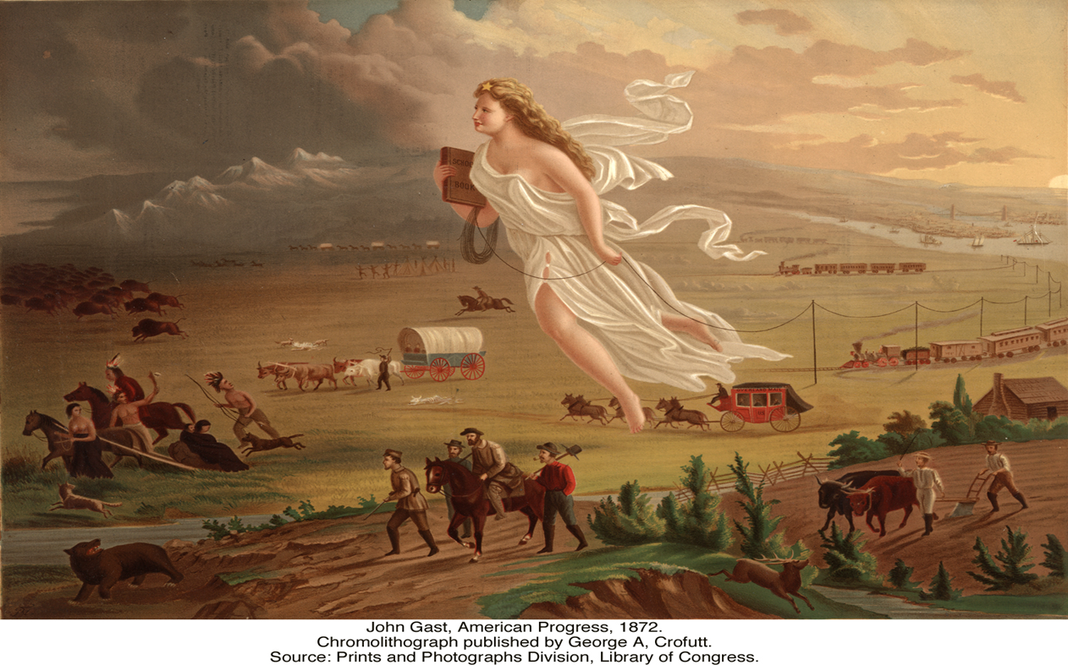
You have 2 minutes to study the image look for as many details about the people, objects and activities (actions) going on in the painting

Slide 30
American Progress by John Gast 1872
1. Fill in the Chart
People | Objects | Activities
2. Answer the remaining questions using the painting

